Slide 1
National History Day
2014
Leadership and Legacy in History

Slide 2

Defining “Leadership”: a person who guides, inspires or directs a group; a motivator
Military
Politics
Government
Communities
Social Movement
In Science, Arts, Education, Religion,
Economics
Local
State
National
International
Elected
Appointed
Seize

Slide 3
Qualities of a Leader
    Passionate
    Embrace change
    Inquisitive
    Problem solvers

Slide 4
Defining “Legacy”: anything handed down from the past, as from an ancestor or predecessor
Social
Natural
Cultural
Political
Economic
Environmental
Historical
Influences
Local
State
National
International

Slide 5
Helpful Steps in Choosing a Topic

Slide 6
Background Information
About Your Topic
Pick a time period you like.
    What are some events that occurred during that time?
    Where did they occur?
    Who was involved?
Pick an event or person of that time period.
    What are the pros of that person or event?
    What are the cons of that person or event?
What or who specifically instigated that legacy?
    An act?
    An idea?
What was the effect?
    Over time?
    End result? Evidence about its importance

Slide 7
Topic Selection:
Questions to Consider
Does the topic relate to
                A revolution?
                A reaction?
                A reform?
  Why is this topic important?
  Why am I interested in this topic?
Are there enough sources to help me?
Did it happen at least 25 years ago?

Slide 8
Important Tips!
Read lots of background information about the time in
which the topic took place.
Think of the topic’s place in history and its impact on the
course of human events.
To win: discuss efforts and the results of those efforts;
look for historical significance and provide
evidence from your research to back up your
report.

Slide 9
Helpful Graphic Organizer
http://www.chicagohistoryfair.org/images/stories/pdfs/1_determine.pdf

Slide 10
Narrow Your Topic!
Theme: Rights in History
Interest: Native Americans
Topic: Treaty Rights
Issue: 1788 Fort Schuyler
Treaty
Theme: Individual in History
Interest: Women's Rights
Topic: Suffrage Movement
Issue/Individual: Alice Paul
Theme: Innovation in History
Interest: History of Science
Topic: Medical Discoveries
Issue/Discovery: Penicillin
Theme: Turning Points in History
Interest: The Civil War
Topic: Battles
Issue/Events: The Battle of
Gettysburg

Slide 11
Sample Topics
Common U.S. History Topics Chart
Common World History Topics Chart
Sample Topics List

Slide 12
The Thesis Statement

Slide 13
Develop a Thesis Statement
Projects should do more than just tell a story
Develop your own argument of the historical impact of the person, event, pattern or idea
Point you make is called a thesis statement. Your thesis statement
explains what you believe to be the impact and significance of
your topic in history.
Topic: Susan B. Anthony
Thesis Statement: Susan B. Anthony was a voice of women in the mid 1800s. Her leadership shaped the rights of women as equal citizens in the U.S. leaving a legacy that formed the view and role of women as residents of a free nation.

Slide 14
A Good Thesis Statement
Addresses a narrow topic
Explains what you think is of historical significance of the topic
Connects your topic to the theme of NHD
Includes the words of the theme
Tells what you plan to write about in your paper
Takes a stand on your topic
A Guide to Historical Research Through the National History Day Program. Santa Barbara, CA: ABC-CLIO, 2006. Print.

Slide 15
Thesis Statement Examples
“Immigration to Milwaukee”: a topic, but not a thesis statement; is not specific. What part of immigration will be explored?
“Lizzie Black Kander and Jewish Immigration to Milwaukee from 1880 -1920”: narrower, but not a thesis statement; expresses no opinion or argument about Kander’s importance.
“Lizzie Kander used her cooking classes and The Settlement Cookbook to teach Milwaukee’s Jewish immigrants about American culture”: close, but not a thesis statement. How did the classes and book help the immigrants?
“Through her cooking classes and her book, The Settlement Cookbook, Lizzie Kander introduced Milwaukee’s Jewish immigrants to American culture, which helped them assimilate.”
A Guide to Historical Research Through the National History Day Program. Santa Barbara, CA: ABC-CLIO, 2006. Print.

Slide 16
Tips to Think About in Your Thesis Statement
Why is my topic significant in history?
What are opposing arguments about this?
What evidence supports my argument?
What evidence supports the opposing argument?
Which argument is strongest? Why?
Should I change my argument? How?
Can I strengthen my argument by planning more evidence? How?
Adapted from “A Student’s Guide to National History Day: Almost Everything You Need to Know to Get Started on Your History Day Adventure.” Wisconsin History Day

Slide 17
Sources
Primary and Secondary

Slide 18
Gathering and Recording Information
…students must credit sources from which they gathered information. To begin the process, however, it is important for the student to collect the critical information from each source as they read: the author's name, title, publisher, and date of publication, and page number for quotes.
http://www.nhd.org/EightSteps.htm

Slide 19
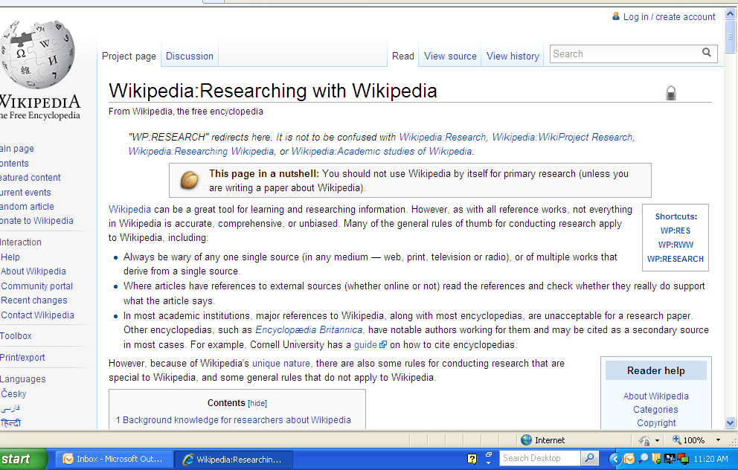
No! No! No!

Slide 20
Primary Sources
Definition: A primary source is a piece of information about a historical event or period in which the creator of the source was an actual participant in or a contemporary of a historical moment. The purpose of primary sources is to capture the words, the thoughts and the intentions of the past. Primary sources help you to interpret what happened and why it happened. Materials written or produced in the time period of the historical event.
Examples: include documents, artifacts, photos, historic sites, songs, speeches, diaries, letters, or other written and tangible items created during the historical period you are studying.
Building Historical Context and Conducting Research. NHD National History Day. Cecil Hall University of Maryland College. Web. 27 Sept. 2009
http://www.chicagohistoryfair.org/images/stories/pdfs/2_stuff_of_history.pdf

Slide 21
Secondary Sources
Definition: A secondary source is a source that was not created first-hand by someone who participated in the historical era. Secondary sources are usually created by historians, but based on the historian's reading of primary sources. Secondary sources are usually written decades, if not centuries, after the event occurred by people who did not live through or participate in the event or issue.
Materials written by an author who was not an eyewitness or participant in the historical event.
Examples: textbooks, encyclopedia articles
Building Historical Context and Conducting Research. NHD National History Day. Cecil Hall University of Maryland College. Web. 27 Sept. 2009

Slide 22
Interpret the Primary Sources
Why are the sources you've chosen useful for answering the questions you want answered?
Who is the author/producer/storyteller?
What was the purpose of the letter, diary, speech, etc.?
What are the key biases you see in this source?
Who preserved this source of historical information and why?

Slide 23

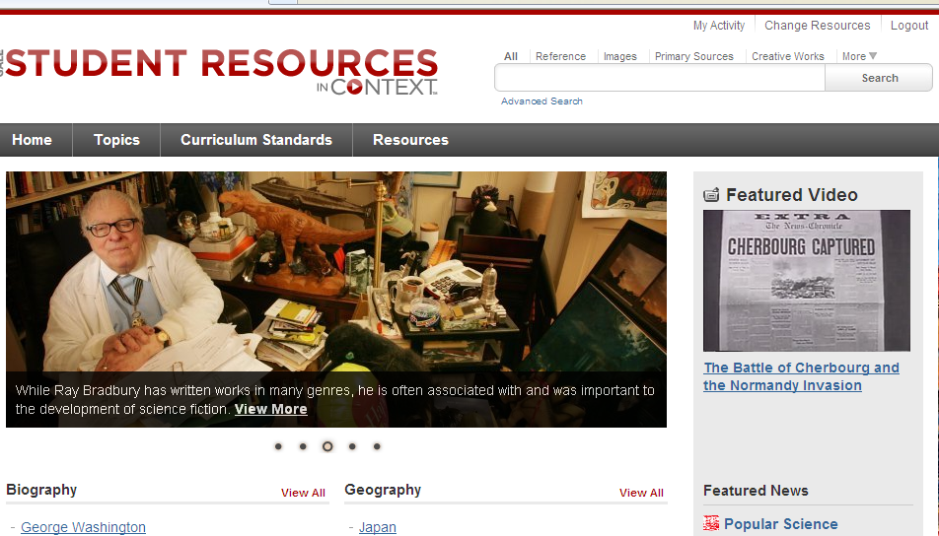
Resources
FBISD Digital Resources
Limit your searches on GALE by selecting Primary Sources

Slide 24
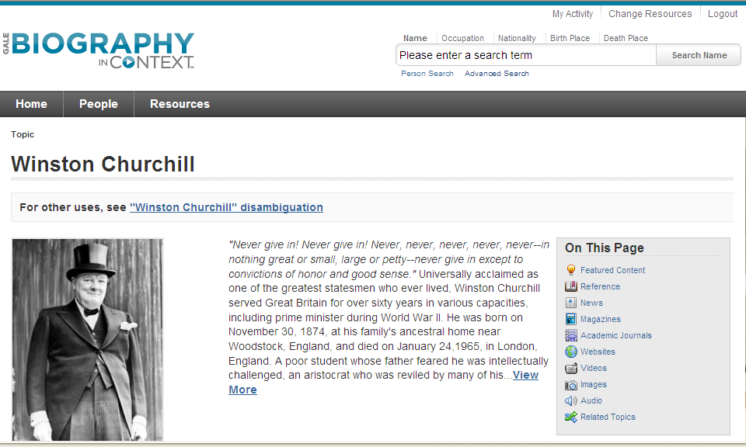
Resources
FBISD Digital Resources
GALE-Biography in Context: Video, Images, and Speeches

Slide 25

Resources
FBISD Digital Resources
Video, Images, and Speeches

Slide 26
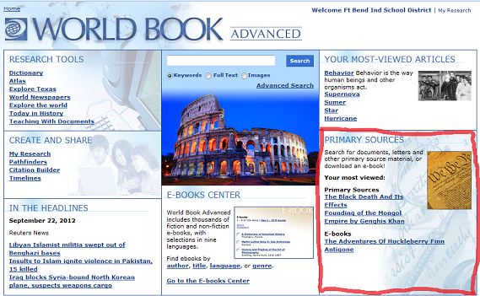
World Book Advanced

Slide 27
Resources
Other Websites
http://www.nhd.org/researchcentral.htm
  Research Methods and Materials
    Museums and Historic Sites
    National Libraries, Archives and Directories
  Primary Sources on the Web
    US History Primary Sources and Major Web Sites
    World History Primary Sources and Major Web Sites
    Photos, Maps and Other Images
    Music

Slide 28
www.history.com video clips, speeches, debates
www.wdl.org offers primary source materials from countries from around the world
www.si.edu The Smithsonian Institution web site
http://www.nhd.org/Texaspage.htm for state websites
http://www.nationalhistoryday.org/educatorresources.htm
http://www.ourdocuments.gov/index.php?flash=true& Primary sources
100 milestone docs
http://www.pbs.org/history/history_united.html
http://www.womeninworldhistory.com/
http://www.loc.gov Library of Congress
More Resources

Slide 29
Annotated Bibliographies
What are they?

Slide 30
Annotated Bibliographies
Annotated bibliography: The annotations for each source must explain how the source was used and how it helped the student understand the topic. The student should also use the annotation to explain why the source was categorized as primary or secondary. Historians do sometimes disagree and there's not always one right answer, so students should use the annotation to explain why they classified their sources as they did. Students should list only those sources used to develop their entry. An annotation normally should be about 1-3 sentences.
Source (example)
Bates, Daisy. The Long Shadow of Little Rock. 1st ed. New York: David McKay Co. Inc., 1962.
Annotation (example)
Daisy Bates was the president of the Arkansas NAACP and the one who met and listened to the students each day. This first-hand account was very important to my paper because it made me more aware of the feelings of the people involved.
http://www.nhd.org/EightSteps.htm

Slide 31

Works Cited
A Guide to Historical Research Through the National History Day Program. Santa Barbara, CA: ABC-CLIO, 2006. Print.
"A Student’s Guide to National History Day: Almost Everything You Need to Know to Get Started on Your History Day
Adventure." National History Day. Cecil Hall University of Maryland , 2010. Web. 7 Oct. 2010.
"Building Historical Context and Conducting Research." NHD National History Day. Cecil Hall University of
Maryland College, 27 Sept. 2009. Web. 7 Oct. 2010.
"Eight Steps of Historical Research." National History Day. Cecil Hall University of Maryland , 2010. Web. 7 Oct. 2010.
Merriam-Webster Dictionary. Merriam-Webster, INC., 2013. Web. 25 Aug. 2013.

